Slide 1
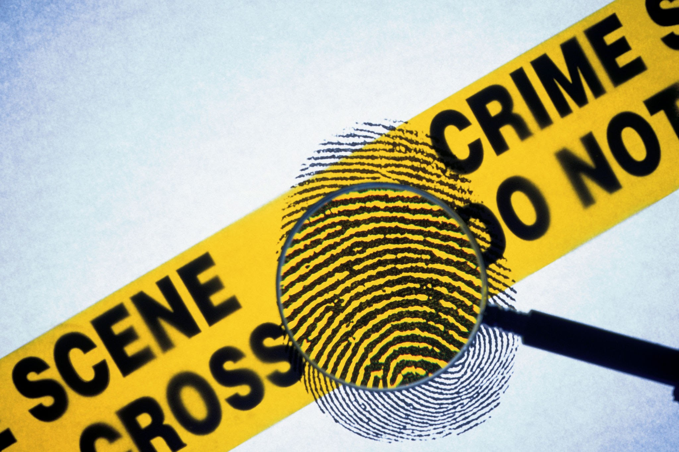

Moreno Crime Network

Slide 2
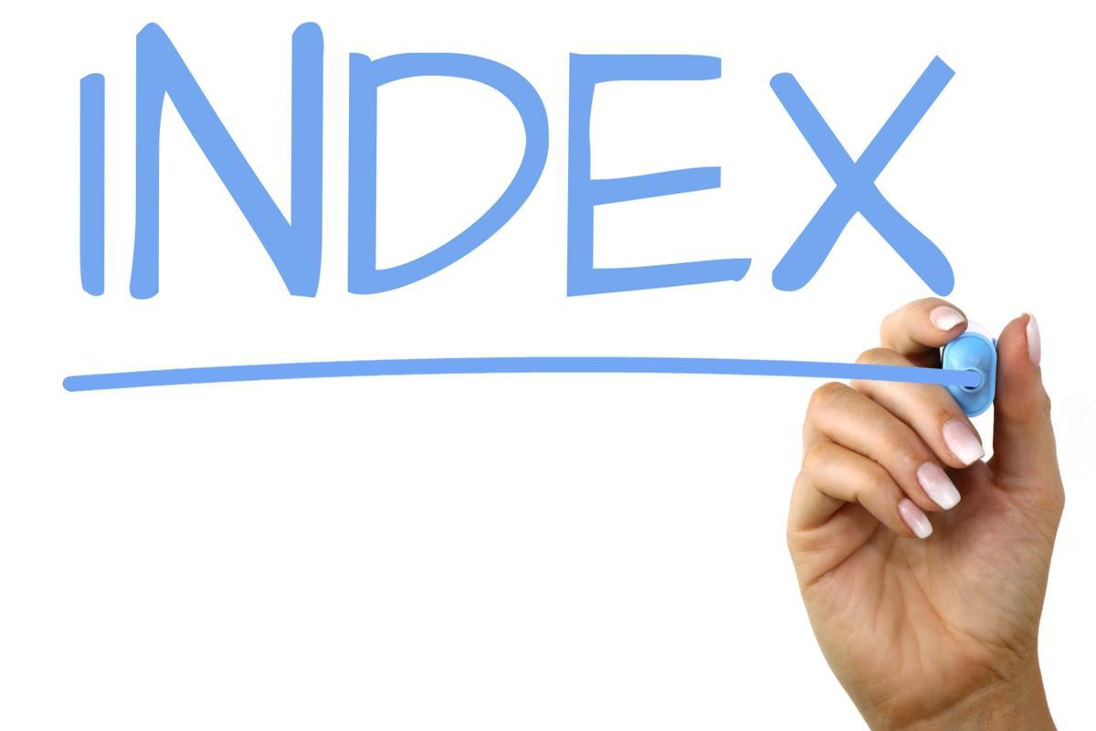
Introduction
Dataset
Research questions
Methods
Result

Slide 3

Introduction
What is a crime network?
A crime network is a group of people who work together to commit crimes in an organized way. They are important to study because they help us understand how organized crime actually works.
They reveal how criminals collaborate
They help identify key players
They show the structure of criminal organizations
They help disrupt and prevent crime
They support scientific research

Slide 4
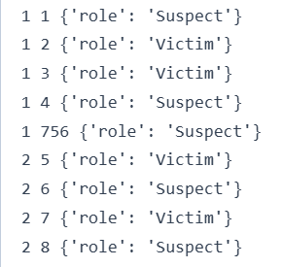
Dataset
This bipartite network contains persons who appeared in at least one crime case as either a suspect, a victim, a witness or both a suspect and victim at the same time. A left node represents a person and a right node represents a crime. An edge between two nodes shows that the left node was involved in the crime represented by the right node.
Dataset source: http://konect.cc/networks/moreno_crime
Dataset details: Graph with 1380 nodes and 1476 edges
The network format: Bipartite.
Filtering keeping only the “suspect” edges.
After filtering and the projection: 490 nodes and 945 edges.

Slide 5
Research questions:
How can network centrality measures distinguish between different structural roles in a criminal organization?
Can we identify lone repeaters, gang leaders, and peripheral 'small fish'?

Slide 6
Bipartite Network: projection on the people
Our analysis of the network started with the projection on the people: visually connecting people throughout the participation to a specific crime.
From here, the structure of criminal organizations is revealed from the computation of the Centrality measure.
In particular the focus will be on: Degree, Closeness, Betweenness and Eigenvector centralities.

Slide 7
Degree Centrality
What is it? Generally speaking, it’s a raw (or normalized) computation of the number of connection for each node. In our case, it computes the number of co-offenders one person is connected to through a crime.
Why use it? In our case, a high centrality can be a signal of an individual participating in a large group or gang of offenders, an individual that commits a high number of crimes with few co-offenders, or a mix of both
Issue: Because of the projection of the bipartite network, someone that committed only one crime with a lot of co-offenders will also result in a high degree even though he is not “central”.

Slide 8
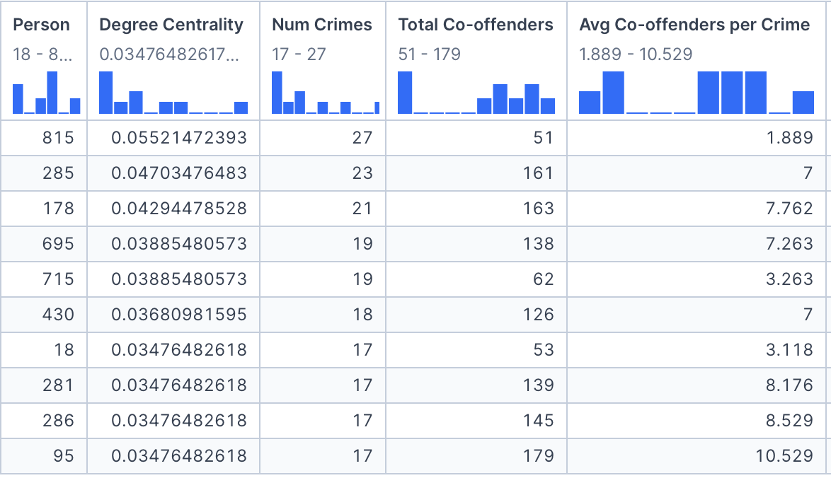
Degree Centrality
The real crime repeaters are identified by a high number of crimes and low number of average co-offenders per crime: 815.
95, 286 and 281 could be both gang members and artefacts for their low number of crimes and high number of average, in this case the criminal is not a strong re-offender as the others because its score comes from a high average.

Slide 9
Closeness Centrality
What is it? quantifies how near a person is to all other people in the network. In our case, it measures how much a criminal is near the others (through crimes) and if it’s at the center or periphery of the network.
Why use it? In our case, a high centrality can be a signal of an individual at the core of a large group or gang of offenders, someone that can reach others easily and so is well informed about the criminal world.
Issue: In the case of large groups, the projection can collapse into a clique and reduce drastically the distances, thus creating artifacts.

Slide 10
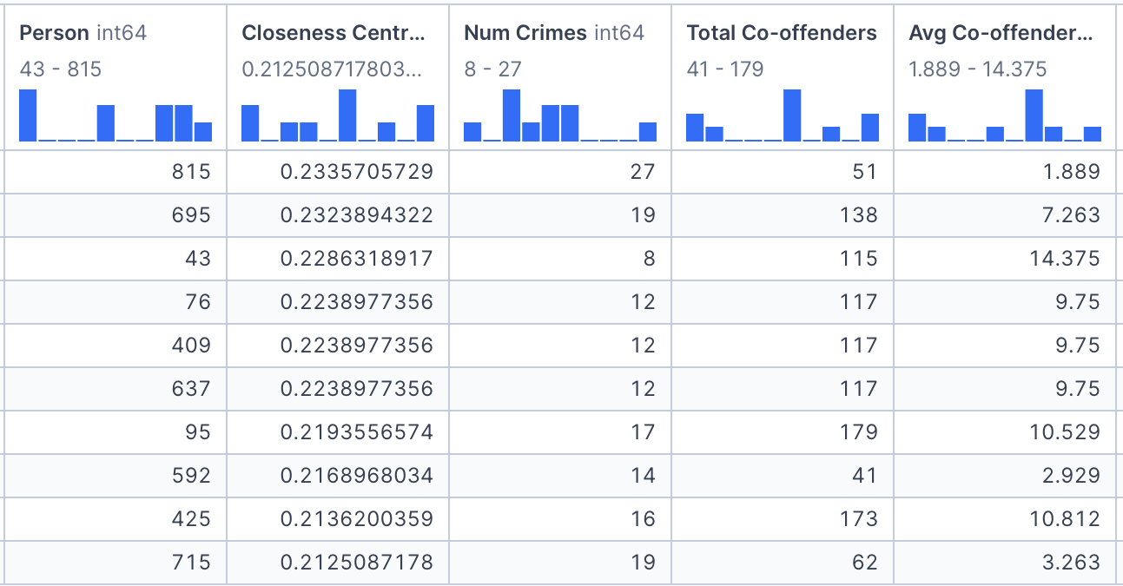
Closeness Centrality
Again 815 appears at the top, and doesn’t look like an artefact. We can now start to think that this person is a real high recidive.
The members of the top 10 are all possible criminals that have connections with many groups, even though they are not suspects of many crimes, like 43.

Slide 11
Betweenness Centrality
What is it? It ranks nodes based on their control over information flow, meaning the extent to which they lie on paths of other nodes. In our case this can be a measure of connectivity between different groups.
Why use it? Analyzing who serves as a bottleneck between different clusters can be essential for operations: communication relies on this individuals.
Issue: This measure can capture also individuals that appear in giant cliques (they are on all the clique’s paths), and so they are not actual bottlenecks.

Slide 12
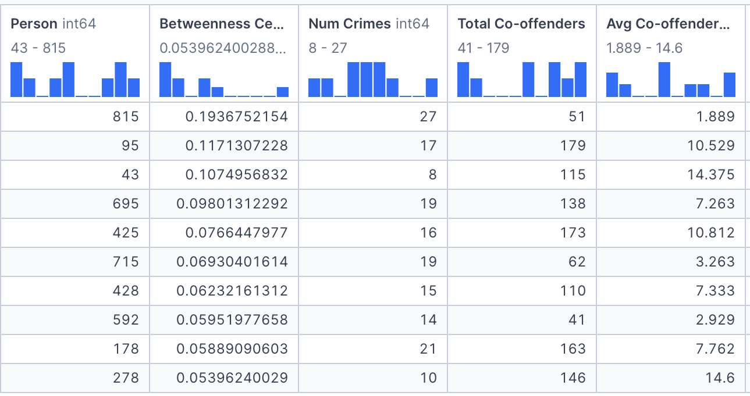
Betweenness Centrality
815 confirms itself at the top, far above the other criminals, meaning that could be an important figure across multiple crimes, even though its average of accomplices is low.
95 shows an interesting behavior, as its number of crimes is high and also a high average: maybe the criminal possess information of different crimes and people.
We still have artefacts like 43 and 278.

Slide 13
Eigenvector Centrality
What is it? Nodes are ranked according to the centrality of the neighbors. In our case, we will find criminals that appear in highly connected clusters, that could be gangs.
Why use it? We will try to look for groups that operate together among crimes and potential leaders.
Issue: This measure is the most sensible to the projection’s artefacts, as high scores will be assigned to large group crimes, and everyone in that clique will result important.

Slide 14
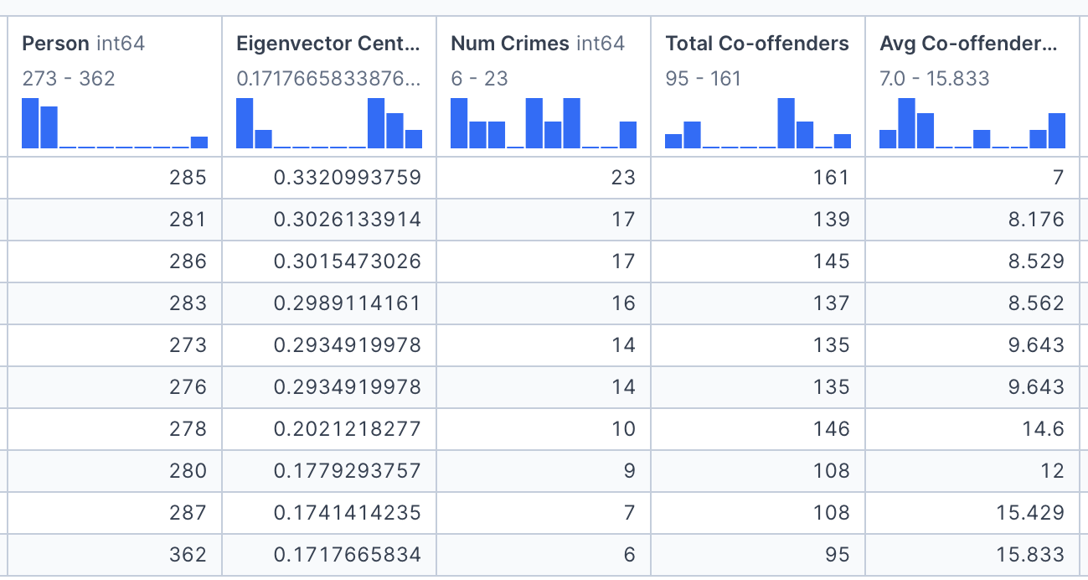
Eigenvector Centrality
From the table is evident that top 10 criminals have high averages of co-offenders, thus spotting cliques that could be gang and raise the value of centrality.
As most of the results are inflated by the projection, so they are biased information, but it could highlight the members of criminal groups leaders like 285.

Slide 15
Conclusions
Degree Centrality: highlighted a dangerous crime repeater and many members of big criminal groups.
Closeness Centrality: highlighted potentially well informed and connected suspects from big criminal groups, even though the risk of artifact is high.
Betweenness Centrality: highlighted some possible key figures in the information flow of the criminal network.
Eigenvector Centrality: allowed to spot gangs, but also a potential leader or informant that possess contacts with other important suspects.

Slide 16
Teamwork:
Divided the work based on our strengths and supported each other to overcome analytical challenges.
Relied on tools like Deepnote and Google Slides to work simultaneously on data analysis and visual outputs.
Prioritized class hours for hands-on collaboration, brainstorming, and idea sharing, while maintaining constant communication via WhatsApp to stay aligned on updates.
Conducted dedicated review meetings and mock presentations to finalize content, coordinate delivery, and provide constructive feedback to one another.

Slide 17
Thank You

